Slide 1


SMART INDIA HACKATHON 2025
Problem Statement ID – SIH25050
Problem Statement Title – Smart Traffic Management System for Urban Congestion
Theme – Transportation and logistics
PS Category – Software
Team ID – SIH113
Team Name – Jam Breakers

Slide 2






Unsolved Event Issues
🚦SmartFlow – “Every Signal. Every Vehicle. Zero Congestion.”
This AI-powered traffic management system uses data from simulations, cameras, sensors, and maps to dynamically optimize signal timings through Reinforcement Learning. It reduces congestion, idle time, and pollution, while prioritizing emergency vehicles. The solution is scalable for smart cities and includes a real-time dashboard for monitoring and analytics.
🚦
Fixed-Timer Signals
Inefficient event organization
High Fuel Consumption
& Pollution
⛽
Increased fuel & pollution
🚦
🚦
Preprocessing & Feature Extraction
👮
Manual Monitoring
📊 Data-Driven
Approach
Proposed Solution
Slow incident response
🗺️
Limited Scalability
🚦
🚦
Hard city-wide expansion
SmartFlow
“Every Signal,
Every Vehicle,
Zero Congestion.”
Every Signal. Every Vehicle.
Zero Congestion
📊 AI Model
Training
Deployment &
Dashboard
📉
Reactive Rather Than
Predictive
🚦
No congestion
forecasting
Intelligent Decision Making

Slide 3
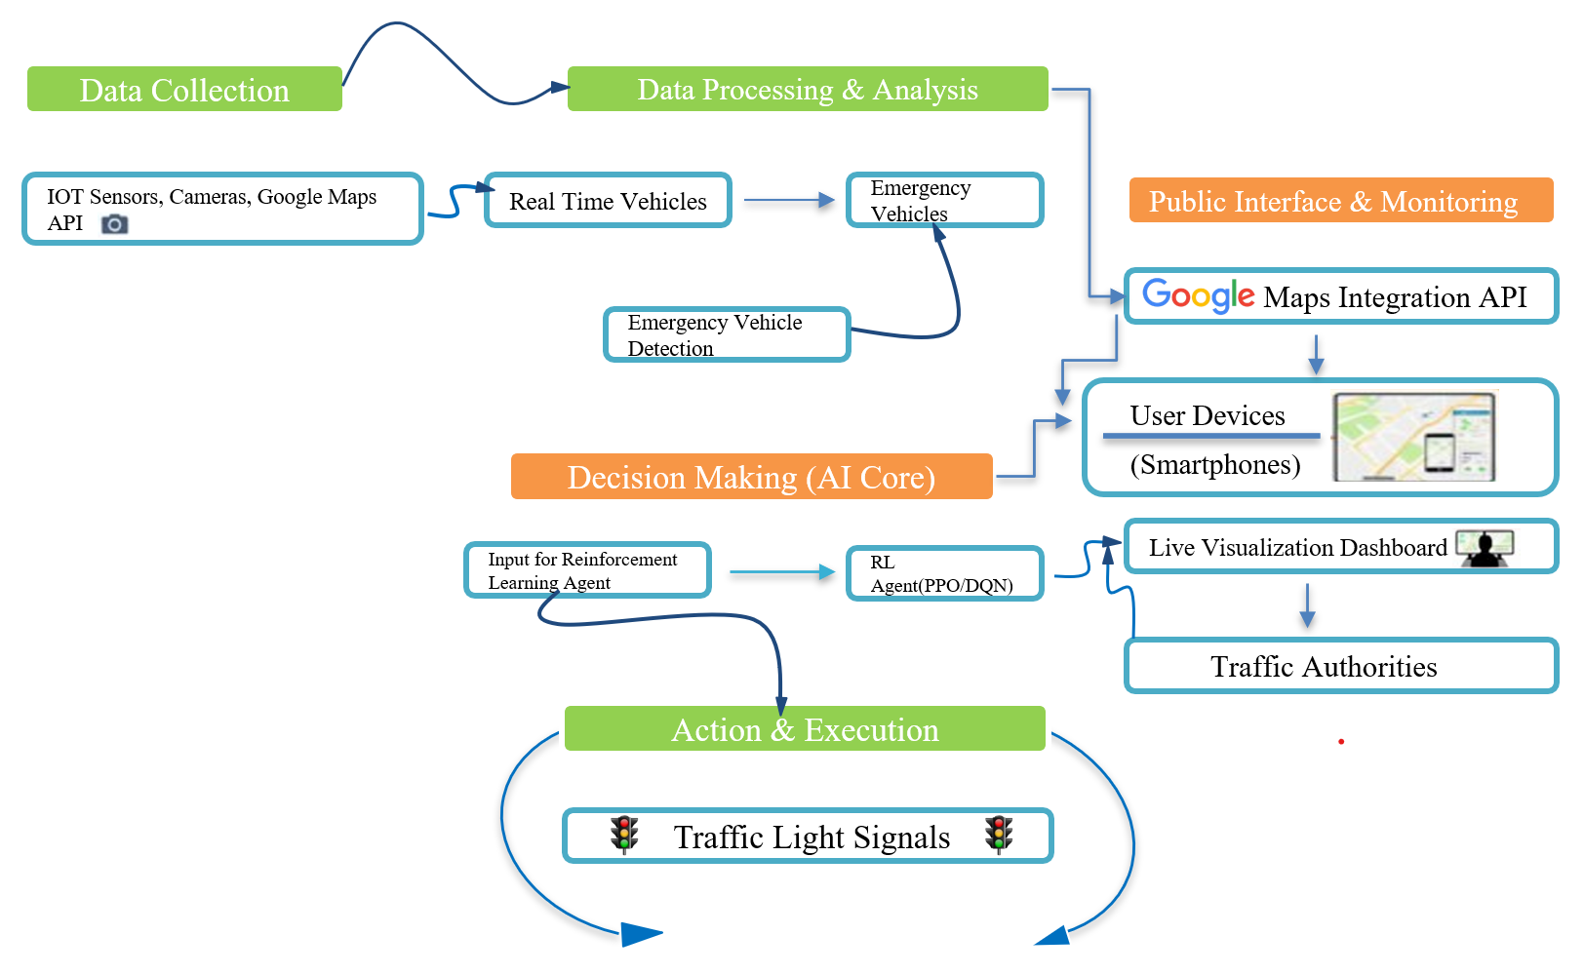
TECHNICAL APPROACH
Technical and Hardware Stack
🔹 Hardware
IoT Sensors (traffic density detectors, vehicle counters)
CCTV Cameras (for vehicle detection)
Edge Devices (Raspberry Pi / Jetson Nano for real-time processing)
GPS Modules (for emergency vehicle tracking)
🔹 Application Development
Python (TensorFlow/Keras, PyTorch) – AI/ML model development
SUMO (Simulation of Urban Mobility) – Traffic simulation environment
Streamlit – Real-time monitoring dashboard
🔹 Databases Management
MongoDB – For real-time traffic and sensor data
PostgreSQL / MySQL – Structured historical datasets storage

Slide 4

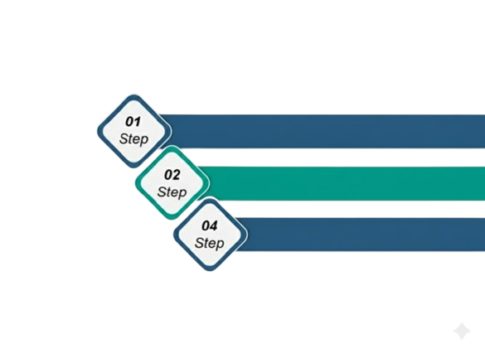
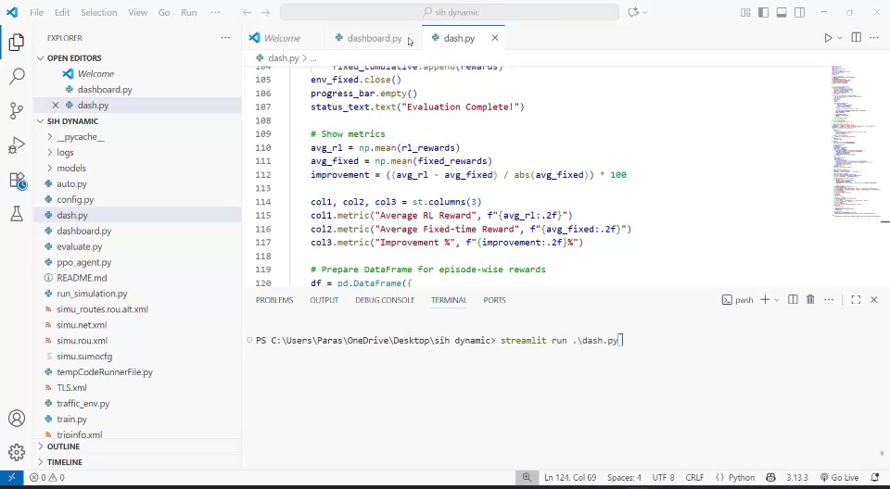
FEASIBILITY AND VIABILITY
FEASIBILITY
Technical Viability
The system can be built with existing, scalable, and open-source tools, requiring no specialized hardware.
Market Viability
There is a clear market demand for the solution, with potential to address the needs of multiple cities and users.
Technical Feasibility:
The system can be built with existing, scalable, and open-source tools.
VIABILITY
Financial
Viability
The project has a low-cost prototype development with strong potential for long-term revenue streams and a high return on investment.
Operational
Viability
The solution
automates key processes and is easy for
end-users to adopt, ensuring smooth and effective integration
Operational Feasibility:
The system is easy to use and automates human intervention, improving traffic management.
Economic Feasibility:
The project is a low-cost prototype with a high potential for long-term savings and productivity gains.
SmartFlow Traffic project is a feasible, viable, and scalable solution for next-gen urban traffic optimization and emergency response.

Slide 5


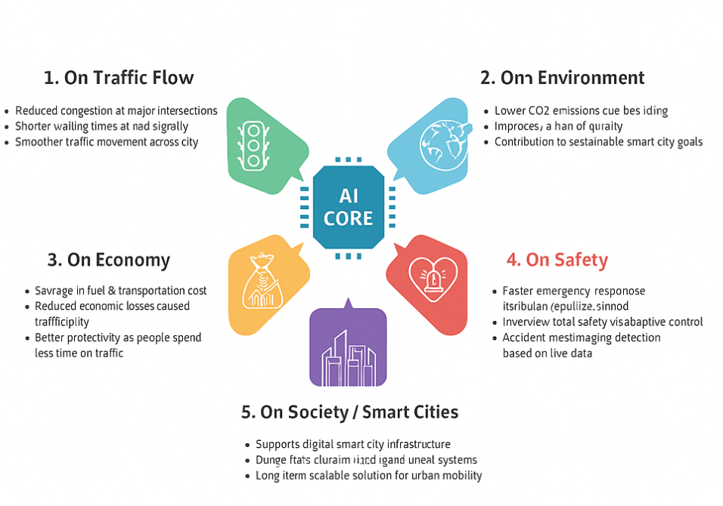
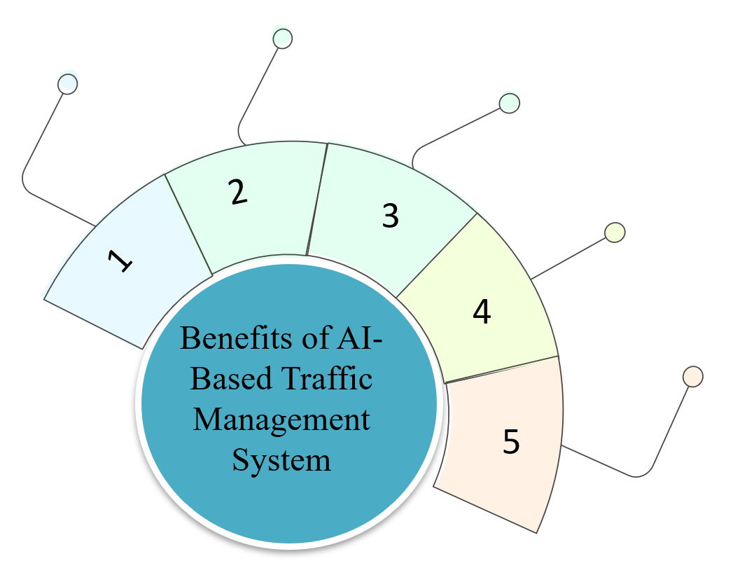
IMPACT AND BENEFITS
For Smart Cities & Authorities
Easy monitoring via real-time dashboard.
Scalable from one junction → whole city.
Supports Smart City Mission & Sustainable Development Goals
For Environment
Reduced air & noise pollution.
Lower greenhouse gas emissions.
Promotes clean & green mobility.
For Economy
Significant cost savings on fuel and time.
Increases productivity (less time wasted in jams).
Long-term savings for government infrastructure
For Safety & Emergency Services
Quicker emergency vehicle movement (ambulance, fire, police).
Accident alerts sent instantly to authorities.
Safer alternative routes suggested.
For Daily Commuters
Faster travel with reduced waiting times.
Less stress and frustration in traffic.
Fuel savings on daily routes.

Slide 6





RESEARCH AND REFERENCES
Traffic Simulation & SUMO
Reinforcement Learning for Traffic Signals
AI & Smart City Applications
SUMO (Simulation of Urban Mobility) – Official Website https://www.eclipse.org/sumo/
SUMO Documentation (Tutorials, Examples) https://sumo.dlr.de/docs/
“A Reinforcement Learning Approach for Traffic Signal Control” – Research Paper
Smart Traffic Management using AI – IEEE Paper https://ieeexplore.ieee.org/document/9394200
Google Maps Traffic Data (API) https://developers.google.com/maps/documentation/traffic
This work is supported by extensive literature on AI-driven traffic management and smart city development. References include research papers, government reports, and case studies on intelligent transportation systems. Additional insights were derived from industry publications, IoT applications, and real-world smart traffic projects.
https://arxiv.org/abs/1904.04762
SIH113
6

